Slide 1
Dimensionality reduction

Slide 2
Why dimensionality Reduction?
Generally, it is easy and convenient to collect data
An experiment
Data accumulates in an unprecedented speed
Data preprocessing is an important part for effective pattern recognition
Dimensionality reduction is an effective approach to downsizing data

Slide 3
Why dimensionality Reduction?
Most machine learning/pattern recognition techniques may not be effective for high-dimensional data
Curse of Dimensionality
Accuracy and efficiency may degrade rapidly as the dimension increases.
The intrinsic dimension may be small.
For example, the number of genes responsible for a certain type of disease may be small

Slide 4
Why dimensionality Reduction?
Visualization: projection of high-dimensional data onto 2D or 3D.
Data compression: efficient storage and retrieval.
Noise removal: positive effect on query accuracy.

Slide 5


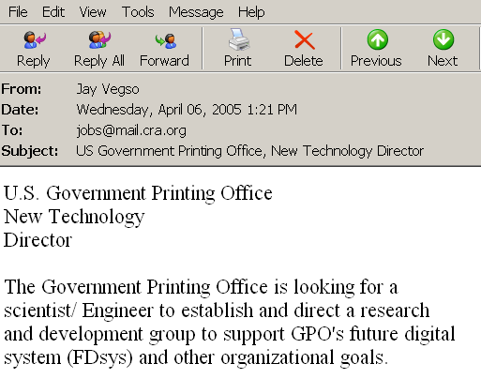

Document classification
Terms
Web Pages
Emails
T₁ T₂ ….…… T_{N}
C
Sports
12 0 ….…… 6
D₁
D₂
Travel
3 10 ….…… 28
Documents
…
…
…
…
D_{M}
0 11 ….…… 16
Jobs
Internet
Task: To classify unlabeled documents into categories
Challenge: thousands of terms
Solution: to apply dimensionality reduction
ACM Portal
IEEE Xplore
PubMed
Digital Libraries

Slide 6
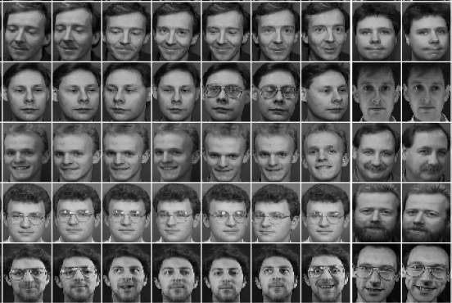
Other examples
Face images
Handwritten digits

Slide 7
dimensionality Reduction
Reduces time complexity: Less computation
Reduces space complexity: Less parameters
Saves the cost of observing/computing the feature

Slide 8
dimensionality Reduction
Key methods of dimensionality reduction
Feature Selection
Feature Extraction

Slide 9
Feature selection vs extraction
Feature selection:
Feature extraction:
Choosing k<d important features, ignoring the remaining d – k. These are Subset selection algorithms
Project the original x_{i} , i =1,...,d dimensions to new k<d dimensions, z_{j} , j =1,...,k

Slide 10
Feature selection
Choosing an optimal subset of features
(Subset of m out of n)

Slide 11
Feature extraction
Mapping of the original high-dimensional data onto a lower-dimensional space

Slide 12
Feature extraction
Given a set of data points of p variables
Compute their low-dimensional representation:

Slide 13
Feature Selection

Slide 14
Contents: Feature Selection
Introduction
Feature subset search
Models for Feature Selection
Filters
Wrappers
Genetic Algorithm

Slide 15
Introduction
You have some data, and you want to use it to build a classifier, so that you can predict something (e.g. likelihood of cancer)
The data has 10,000 fields (features)

Slide 16
Introduction
You have some data, and you want to use it to build a classifier, so that you can predict something (e.g. likelihood of cancer)
The data has 10,000 fields (features)
You need to cut it down to 1,000 fields before
you try machine learning. Which 1,000?

Slide 17
Introduction
You have some data, and you want to use it to build a classifier, so that you can predict something (e.g. likelihood of cancer)
The data has 10,000 fields (features)
You need to cut it down to 1,000 fields before
you try machine learning. Which 1,000?
This process of choosing the 1,000 fields to use is an example of Feature Selection

Slide 18
Data sets with many features
Gene expression datasets (~10,000 features)
http://www.ncbi.nlm.nih.gov/sites/entrez?db=gds
Proteomics data (~20,000 features)
http://www.ebi.ac.uk/pride/

Slide 19
Feature selection: why?
Source: http://elpub.scix.net/data/works/att/02-28.content.pdf

Slide 20
Feature Selection: why?
Quite easy to find lots more cases from papers, where experiments show that accuracy reduces when you use more features
Questions?
Why does accuracy reduce with more features?
How does it depend on the specific choice of features?
What else changes if we use more features?
So, how do we choose the right features?

Slide 21
Why accuracy reduces ?
Note: Suppose the best feature set has 20 features. If you add another 5 features, typically the accuracy of machine learning may reduce. But you still have the original 20 features!! Why does this happen???

Slide 22
Noise/explosion
The additional features typically add noise
Machine learning will pick up on spurious correlations, that might be true in the training set, but not in the test set
For some ML methods, more features means more parameters to learn (more NN weights, more decision tree nodes, etc…) – the increased space of possibilities is more difficult to search

Slide 23
Feature subset search
x₂
x₂
x₁
x₁
X₂ is important, X₁ is not
X₁ is important, X₂ is not
x₃
x₂
x₁
X₁ and X₂ are important, X₃ is not

Slide 24
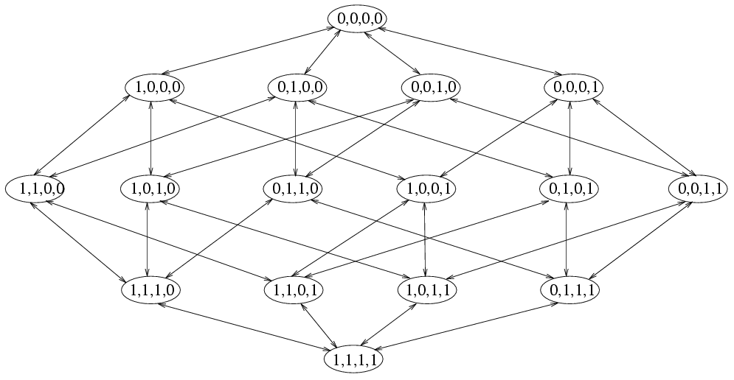
Subset search problem
An example of search space (Kohavi & John 1997)
Forward
Backward

Slide 25
Different aspects of search
Search starting points
Empty set
Full set
Random point
Search directions
Sequential forward selection
Sequential backward elimination
Bidirectional generation
Random generation
Search Strategies
Exhaustive/Complete
Heuristics

Slide 26
Exhaustive search
Original dataset has N features
You want to use a subset of k features
A complete FS method means: try every subset of k features, and choose the best!
The number of subsets is N! / k!(N−k)!
What is this when N is 100 and k is 5?
What is this when N is 10,000 and k is 100?
75,287,520
Actually it is around 5 × 10^{35,101}
There are around 10⁸⁰ atoms in the universe

Slide 27
Forward Search
These methods `grow’ a set S of features –
S starts empty
Find the best feature to add (by checking which one gives best performance on a validation set when combined with S).
If overall performance has improved, return to step 2; else stop

Slide 28
Backward Search
These methods ‘remove’ features one by one.
S starts with the full feature set
Find the best feature to remove (by checking which removal from S gives best performance on a validation set)
If overall performance has improved, return to step 2; else stop

Slide 29
Models for Feature Selection
Two models for Feature Selection
Filter methods
Carry out feature selection independent of any learning algorithm and the features are selected as a pre-processing step
Wrapper methods
Use the performance of a learning machine as a black box to score feature subsets

Slide 30
Filter Methods
A filter method does not make use of the classifier, but rather attempts to find predictive subsets of the features by making use of simple statistics computed from the empirical distribution.

Slide 31
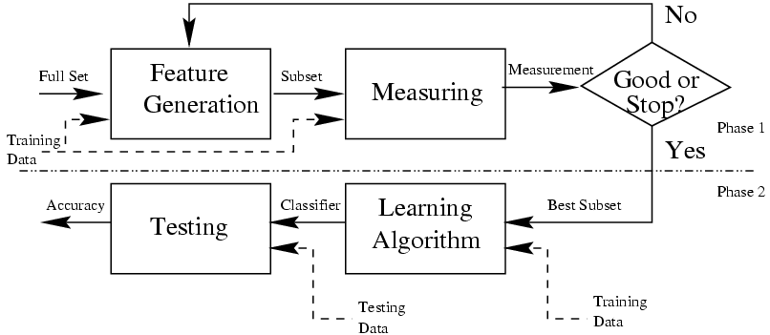
Filter Methods

Slide 32
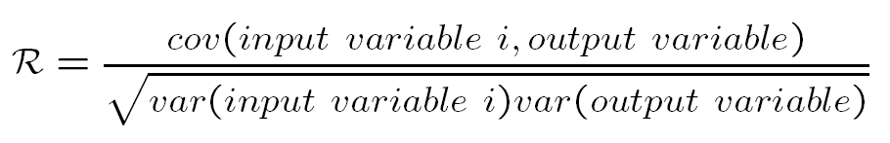
Filter Methods
Ranking/Scoring of features
Select best individual features. A feature evaluation function is used to rank individual features, then the highest ranked m features are selected.
Although these methods can exclude irrelevant features, they often include redundant features.
Pearson correlation coefficient

Slide 33
Filter Methods
Minimum Redundancy Maximum Relevance
a good
predictor set
maximum relevance
minimum redundancy
maximal power in discriminating between different classes
minimal correlation among features (members of predictor set)

Slide 34
Wrapper Methods
Given a classifier C and a set of feature F, a wrapper method searches in the space of subsets of F, using cross validation to compare the performance of the trained classifier C on each tested subset.

Slide 35
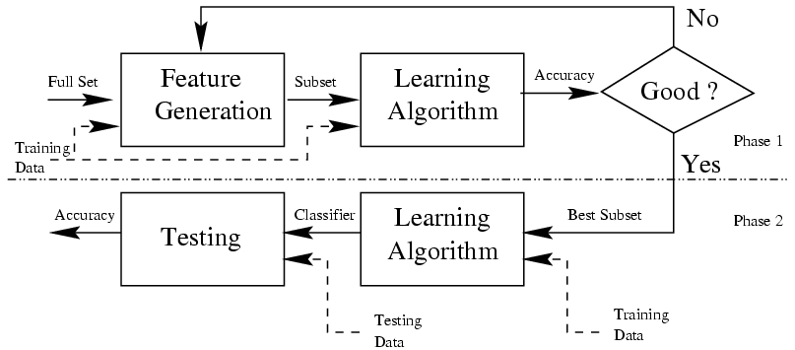
Wrapper Methods

Slide 36
Wrapper Methods
Say we have predictors A, B, C and classifier M. We want to find the smallest possible subset of {A,B,C}, while achieving maximal performance
FEATURE SET CLASSIFIER PERFORMANCE
{A,B,C} M 98%
{A,B} M 98%
{A,C} M 77%
{B,C} M 56%
{A} M 89%
{B} M 90%
{C} M 91%
{.} M 85%

Slide 37

“Genetic Algorithms are good at taking large, potentially huge search spaces and navigating them, looking for optimal combinations of things, solutions you might not otherwise find in a lifetime.”
- Salvatore Mangano
Computer Design, May 1995
Genetic Algorithms

Slide 38
First – A Biology Lesson
A gene is a unit of heredity in a living organism
Genes are connected together into long strings called chromosomes
A gene represents a specific trait of the organism, like eye colour or hair colour, and has several different settings.
For example, the settings for a hair colour gene may be blonde, black or brown etc.
These genes and their settings are usually referred to as an organism's genotype.
The physical expression of the genotype – the organism itself - is called the phenotype.

Slide 39
First – A Biology Lesson
Offsprings inherit traits from parents
An offsporint may end up having half the genes from one parent and half from the other - recombination
Very occasionally a gene may be mutated – Expressed in an organism as a completely new trait
For example: A child may have green eyes while none of the parents had

Slide 40

Genetic Algorithm is
… Computer algorithm
That resides on principles of genetics and evolution

Slide 41
Genetic algorithms
Search algorithms based on the mechanics of biological evolution
Developed by John Holland, University of Michigan (1970’s)
Provide efficient, effective techniques for optimization and machine learning applications
Widely-used today in business, scientific and engineering circles

Slide 42
Genetic Algorithm
Genetic algorithm (GA) introduces the principle of evolution and genetics into search among possible solutions to given problem
The idea is to simulate the process in natural systems
This is done by the creation within a machine a population of individuals

Slide 43

Genetic algorithm
Survival of the fittest
The main principle of evolution used in GA is “survival of the fittest”.
The good solution survive, while bad ones die.

Slide 44
Applications: Optimization
Assume an individual is going to give you z dollars, after you tell them the value of x and y
x and y in the range of 0 to 10

Slide 45
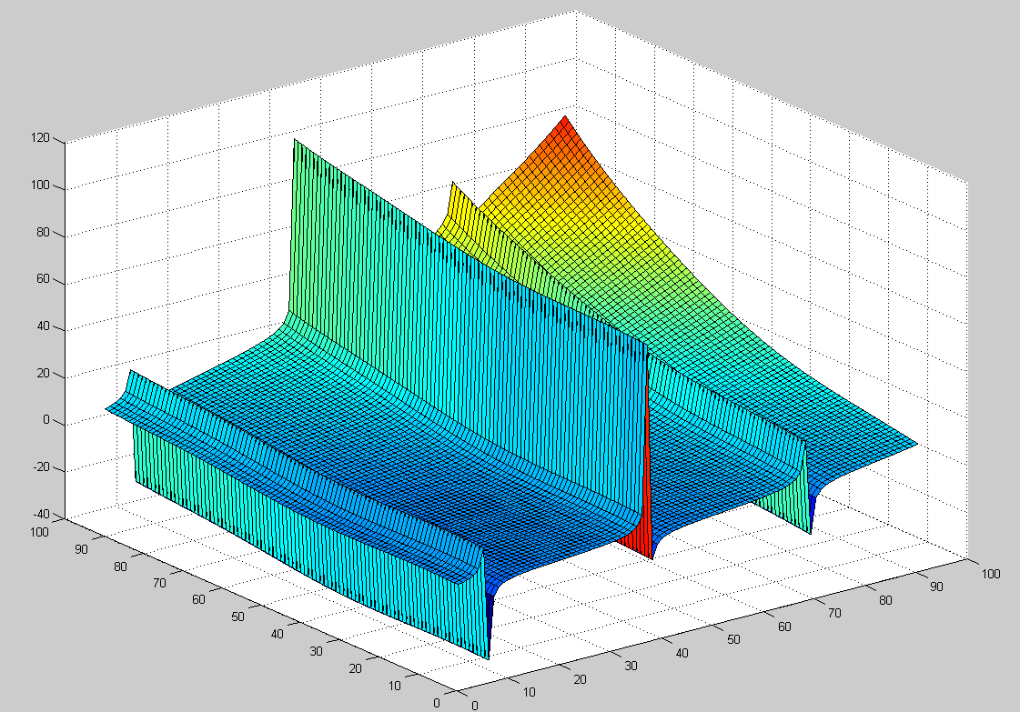
z
x
y

Slide 46
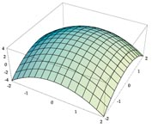
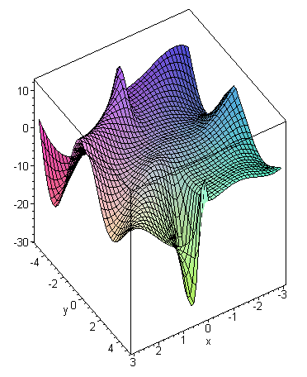
Example Problem I (Continuous)
y = f(x)
Finding the maximum (minimum) of some function (within a defined range).

Slide 47
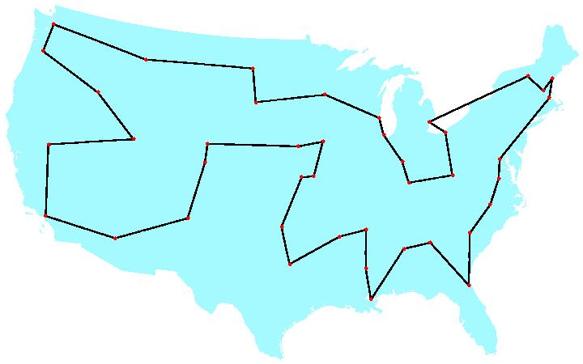
Example Problem II (Discrete)
The Traveling Salesman Problem (TSP)
A salesman spends his time visiting n cities. In one tour he visits each city just once, and finishes up where he started. In what order should he visit them to minimize the distance traveled?
There are (n-1)!/2 possible tours.

Slide 48
Genetic Algorithm
Inspired by natural evolution
Population of individuals
Individual is feasible solution to problem
Each individual is characterized by a Fitness function
Higher fitness is better solution
Based on their fitness, parents are selected to produce offspring for a new generation
Fitter individuals have more chance to reproduce
New generation has same size as old generation; old generation dies
Offspring has combination of properties of two parents
If well designed, population will converge to optimal solution

Slide 49
Genetic Algorithm
Initialize Population
Evaluate Fitness
Yes
satisfy constraints ?
No
Select Survivors
Generate new population
Output Results

Slide 50
Genetic Algorithm
Coding or Representation
Possible solutions to problem
Fitness function
Parent selection
Reproduction
Crossover
Mutation
Convergence
When to stop

Slide 51
Coding – Example: Feature selection
Assume we have 15 features f1 to f15
Generate binary strings of 15 bits as initial population
This is initial population
1 0 1 1 1 0 0 0 1 1 1 0 0 0 1
0 1 1 1 0 1 1 1 1 1 0 0 0 0 0
………………………………
………………………………
1 1 1 1 0 0 0 1 1 1 0 1 1 0 1
Population Size= User defined parameter
One gene
One row = one chromosome =one individual of population
1 means the feature is used – 0 means the feature is not used

Slide 52
Coding: Example
The Traveling Salesman Problem:
Find a tour of a given set of cities so that
Each city is visited only once
The total distance traveled is minimized
Representation is an ordered list of city numbers
1) London 3) Dunedin 5) Beijing 7) Tokyo
2) Venice 4) Singapore 6) Phoenix 8) Victoria
CityList1 (3 5 7 2 1 6 4 8)
CityList2 (2 5 7 6 8 1 3 4)

Slide 53
Fitness Function/Parent Selection
Fitness function evaluates how good an individual is in solving the problem
Fitness is computed for each individual
Fitness function is application depended
For classification – we may use the classification rate as the fitness function
Find the fitness value of each individual in the population

Slide 54
Fitness Function/Parent Selection
Parent/Survivor Selection
RouletteWheel Selection
Tournament Selection
Rank Selection
Elitist Selection

Slide 55
Roulette Wheel Selection
Main idea: better individuals get higher chance
Individuals are assigned a probability of being selected based on their fitness.
p_{i} = f_{i} / Σf_{j}
Where p_{i} is the probability that individual i will be selected,
f_{i} is the fitness of individual i, and
Σf_{j} represents the sum of all the fitnesses of the individuals with the population.

Slide 56
Roulette Wheel Selection
Assign to each individual a part of the roulette wheel
Spin the wheel n times to select n individuals
1/6 = 17%
B
A
C
fitness(A) = 3
fitness(B) = 1
3/6 = 50%
2/6 = 33%
fitness(C) = 2

Slide 57
Tournament Selection
Binary tournament
Two individuals are randomly chosen; the fitter of the two is selected as a parent
Larger tournaments
n individuals are randomly chosen; the fittest one is selected as a parent

Slide 58
Other Methods
Rank Selection
Each individual in the population is assigned a numerical rank based on fitness, and selection is based on this ranking.
Elitism
Reserve k slots in the next generation for the highest scoring/fittest chormosomes of the current generation

Slide 59
Reproduction
Reproduction operators
Crossover
Mutation
Crossover is usually the primary operator with mutation serving only as a mechanism to introduce diversity in the population

Slide 60
Reproduction
Crossover
Two parents produce two offspring
There is a chance that the chromosomes of the two parents are copied unmodified as offspring
There is a chance that the chromosomes of the two parents are randomly recombined (crossover) to form offspring
Generally the chance of crossover is between 0.6 and 1.0
Mutation
There is a chance that a gene of a child is changed randomly
Generally the chance of mutation is low (e.g. 0.001)

Slide 61
Crossover
Generating offspring from two selected parents
Single point crossover
Two point crossover (Multi point crossover)
Uniform crossover

Slide 62
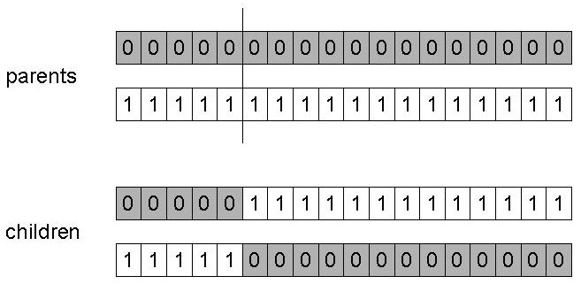
One pont crossover
Choose a random point on the two parents
Split parents at this crossover point
Create children by exchanging tails

Slide 63
One pont crossover
Choose a random point on the two parents
Split parents at this crossover point
Create children by exchanging tails
Parent 1: X X | X X X X X
Parent 2: Y Y | Y Y Y Y Y
Offspring 1: X X Y Y Y Y Y
Offspring 2: Y Y X X X X X

Slide 64
Crossover
00101111000110
00110010001100
00101111001000
11101100000001
Crossover point

Slide 65
Crossover
00101111000110
00101100000001
00110010001100
00101111001000
11101100000001
11101111000110

Slide 66
Crossover
00101111000110
00101100000001
00110010001100
00110111001000
00101111001000
00101010001100
11101100000001
11101111000110

Slide 67
Two point corssover
Two-Point crossover is very similar to single-point crossover except that two cut-points are generated instead of one.
Parent 1: X X | X X X | X X
Parent 2: Y Y | Y Y Y | Y Y
Offspring 1: X X Y Y Y X X
Offspring 2: Y Y X X X Y Y

Slide 68
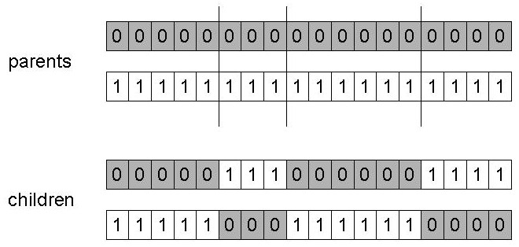
N point crossover
Choose n random crossover points
Split along those points
Glue parts, alternating between parents

Slide 69
Uniform corssover
A random mask is generated
The mask determines which bits are copied from one parent and which from the other parent
Bit density in mask determines how much material is taken from the other parent
Mask: 0110011000 (Randomly generated)
Parents: 1010001110 0011010010
Offspring: 0011001010 1010010110

Slide 70
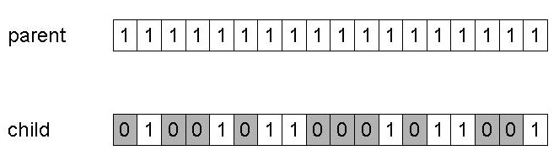
Mutation
Alter each gene independently with a probability p_{m}
p_{m} is called the mutation rate
Typically between 1/pop_size and 1/ chromosome_length

Slide 71
Summary – Reproduction cycle
Select parents for producing the next generation
For each consecutive pair apply crossover with probability p_{c} , otherwise copy parents
For each offspring apply mutation (bit-flip with probability p_{m})
Replace the population with the resulting population of offsprings

Slide 72
Convergence
Stop Criterion
Number of generations
Fitness value
How fit is the fittest individual

Slide 73
GA for feature selection
The initial population is randomly generated
Each chromosome is evaluated using the fitness function
The fitness values of the current population are used to find the off springs of the next generation
The generational process ends when the termination criterion is satisfied
The selected features correspond to the best individual in the last generation

Slide 74
GA for feature selection
GA can be executed multiple times
Example: 15 features, GA executed 10 times

Slide 75
GA for feature selection
Feature categories based on frequency of selection
Indispensable:
Feature selected in each selected feature subset.
Irrelevant:
Feature not selected in any of the selected subsets.
Partially Relevant:
Feature selected in some of the subsets.

Slide 76
GA Worked Example
Suppose that we have a rotary system (which could be mechanical - like an internal combustion engine or gas turbine, or electrical - like an induction motor).
The system has five parameters associated with it - a, b, c, d and e. These parameters can take any integer value between 0 and 10.
When we adjust these parameters, the system responds by speeding up or slowing down.
Our aim is to obtain the highest speed possible in revolutions per minute from the system.

Slide 77
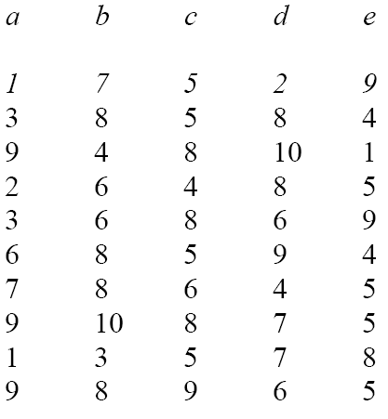
GA Worked Example
Step 1
Generate a population of random strings (we’ll use ten as an example):

Slide 78
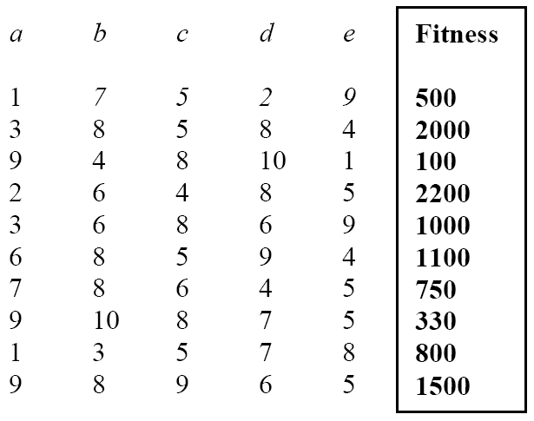
GA Worked Example
Step 2
Feed each of these strings into the machine, in turn, and measure the speed in revolutions per minute of the machine. This value is the fitness because the higher the speed, the better the machine:

Slide 79
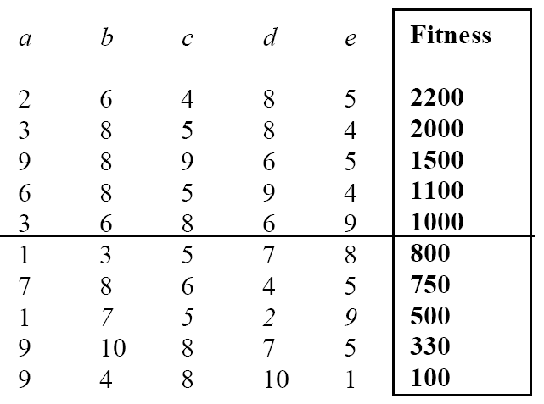
GA Worked Example
Step 3
To select the breeding population, we’ll go the easy route and sort the strings then delete the worst ones. First sorting:

Slide 80
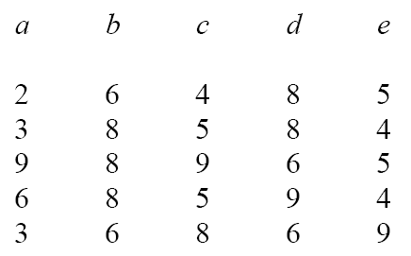
GA Worked Example
Step 3
Having sorted the strings into order we delete the worst half

Slide 81
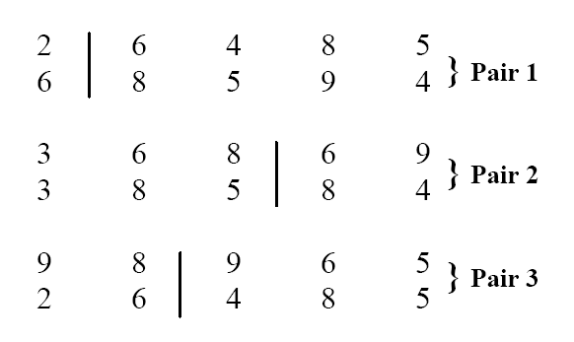
GA Worked Example
Step 4
We can now crossover the strings by pairing them up randomly. Since there’s an odd number, we’ll use the best string twice. The pairs are shown below:

Slide 82
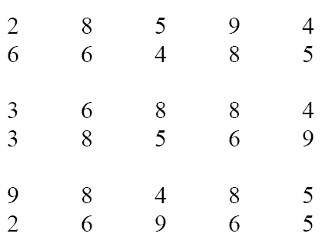
GA Worked Example
Step 4
The crossover points are selected randomly and are shown by the vertical lines. After crossover the strings look like this:
These can now join their parents in the next generation

Slide 83
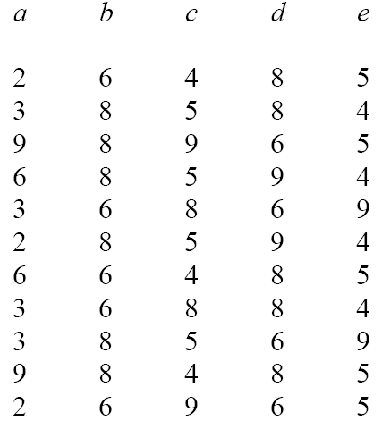
GA Worked Example
Step 4
New Generation

Slide 84
GA Worked Example
Step 4
We have one extra string (which we picked up by using an odd number of strings in the mating pool) that we can delete after fitness testing.

Slide 85
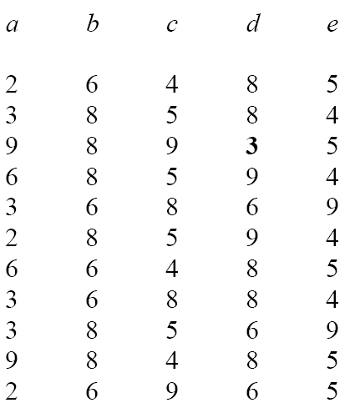
GA Worked Example
Step 5
Finally, we have mutation, in which a small number of numbers are changed

Slide 86
GA Worked Example
After this, we repeat the algorithm from stage 2, with this new population as the starting point.
Keep repeating until convergence

Slide 87
GA Worked Example
Roulette Wheel Selection
The alternative (roulette) method of selection would make up a breeding population by giving each of the old strings a chance of ending up in the breeding population which is proportional to its fitness
Making the fitness for each string the addition of its own fitness with all of those before it

Slide 88
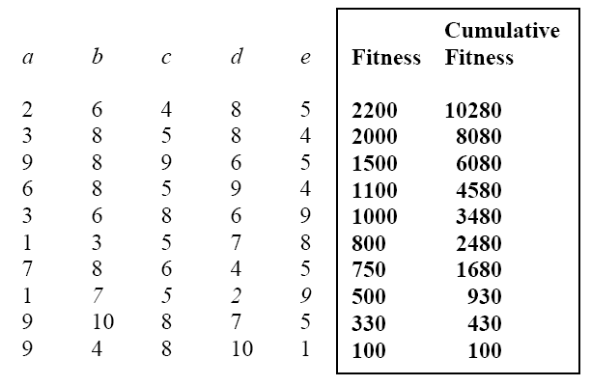
GA Worked Example
Roulette Wheel Selection
If we now generate a random number between 0 and 10280 we can use this to select strings.
If the random number turns out to be between 0 and 100 then we choose the last string.
If it’s between 8080 and 10280 we choose the first string.
If it’s between 2480 and 3480 we choose the string 3 6 8 6 9, etc. You don’t have to sort the strings into order to use this method.

Slide 89
Feature Extraction

Slide 90
Feature Extraction
Unsupervised
Principal Component Analysis (PCA)
Independent Component Analysis (ICA)
Supervised
Linear Discriminant Analysis (LDA)

Slide 91
Principal component Analysis (PCA)
PCA is one of the most common feature extraction techniques
Reduce the dimensionality of a data set by finding a new set of variables, smaller than the original set of variables
Allows us to combine much of the information contained in n features into m features where m < n

Slide 92
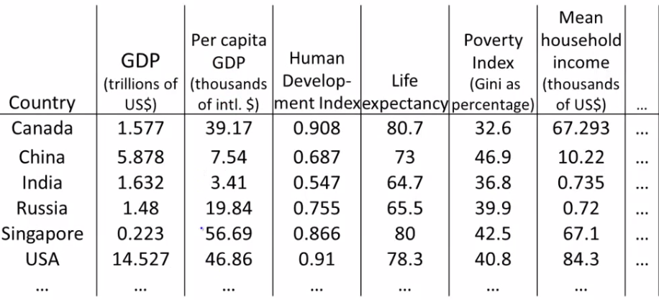
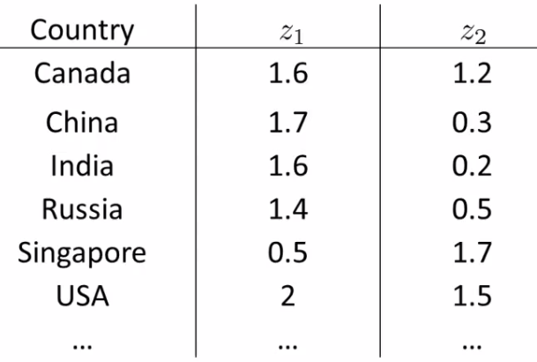

Slide 93
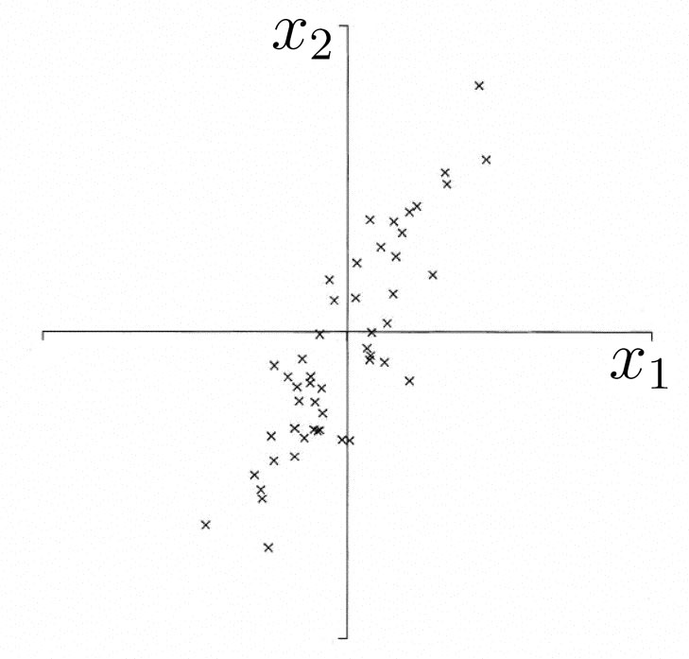
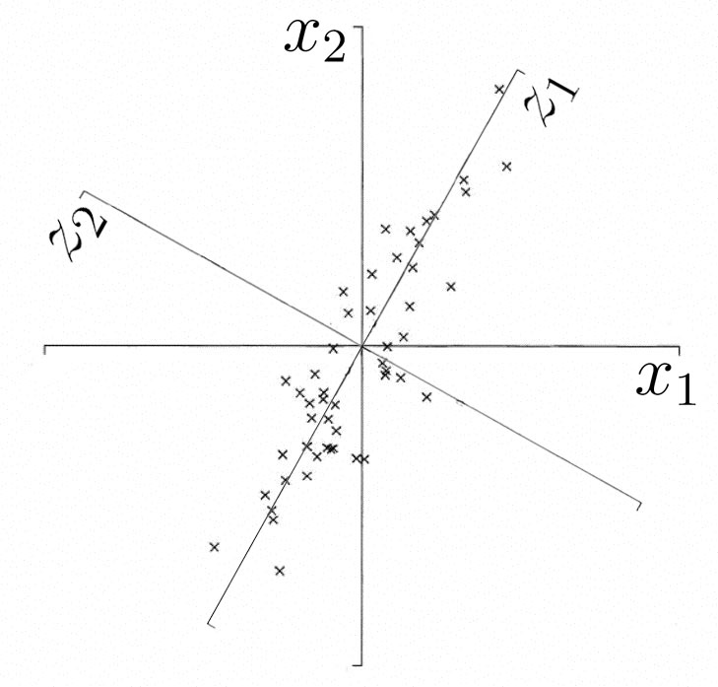
PCA – Introduction
The 1st PC is a minimum distance fit to a line in X space
The 2nd PC is a minimum distance fit to a line in the plane perpendicular to the 1st PC
PCs are a series of linear least squares fits to a sample,
each orthogonal to all the previous.

Slide 94
Principal component Analysis (PCA)

Slide 95
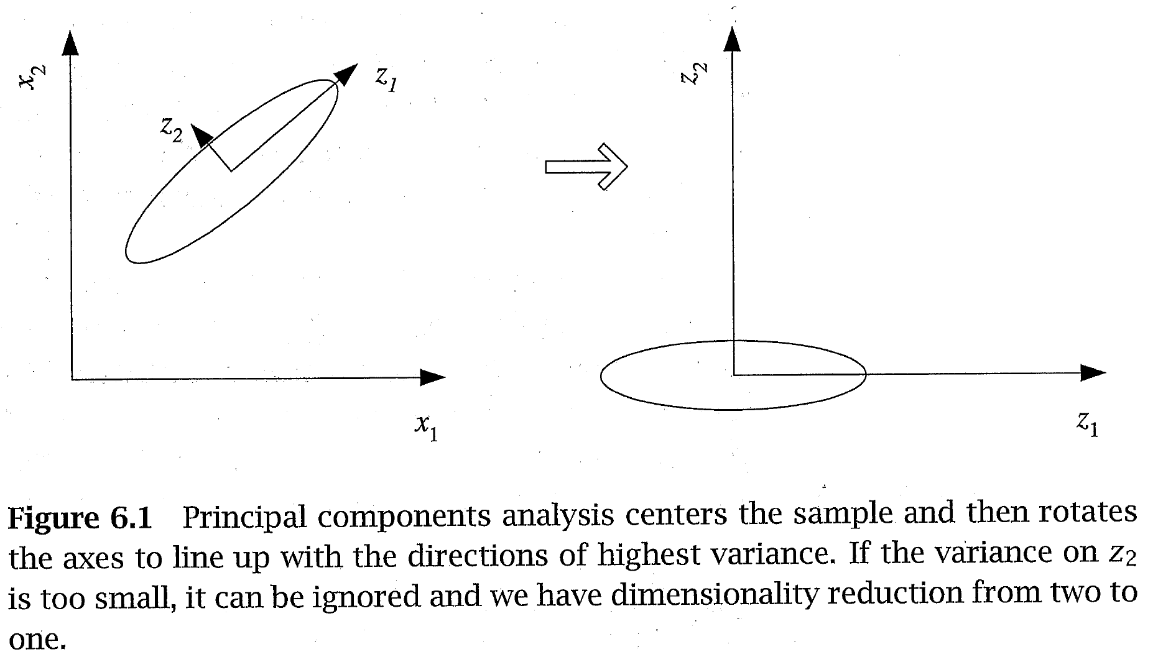
PCA – Introduction
Transform n-dimensional data to a new n-dimensions
The new dimension with the most variance is the first principal component
The next is the second principal component, etc.

Slide 96
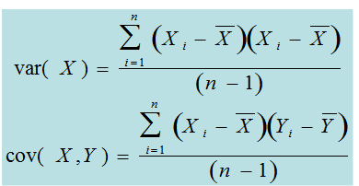
Variance and Covariance
Recap
Variance is a measure of data spread in one dimension (feature)
Covariance measures how two dimensions (features) vary with respect to each other

Slide 97
Covariance
Recap
Focus on the sign (rather than exact value) of covariance
Positive value means that as one feature increases or decreases the other does also (positively correlated)
Negative value means that as one feature increases the other decreases and vice versa (negatively correlated)
A value close to zero means the features are independent

Slide 98
Covariance Matrix
Recap
Covariance matrix is an n × n matrix containing the covariance values for all pairs of features in a data set with n features (dimensions)
The diagonal contains the covariance of a feature with itself which is the variance (which is the square of the standard deviation)
The matrix is symmetric

Slide 99
PCA – Main Steps
Center data around 0
Form the covariance matrix S.
Compute its eigenvectors:
The first p eigenvectors form the p PCs.
The transformation G consists of the p PCs.

Slide 100
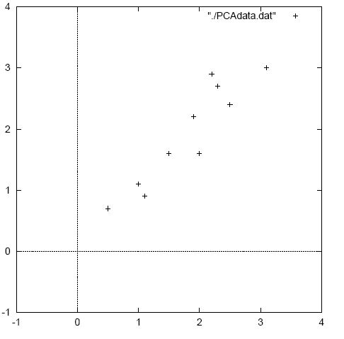
PCA – Worked Example
Data

Slide 101
PCA – Worked Example
Step 1
First step is to center the original data around 0
Subtract mean from each value

Slide 102
PCA – Worked Example
Step 2
Calculate the covariance matrix of the centered data – Only 2 × 2 for this case

Slide 103
PCA – Worked Example
Step 3
Calculate the eigenvectors and eigenvalues of the covariance matrix (remember linear algebra)
Covariance matrix – square n × n ; n eigenvalues will exist
All eigenvectors (principal components/dimensions) are orthogonal to each other and will make a new set of dimensions for the data
The magnitude of each eigenvalue corresponds to the variance along that new dimension – Just what we wanted!
We can sort the principal components according to their eigenvalues
Just keep those dimensions with largest eigenvalues

Slide 104
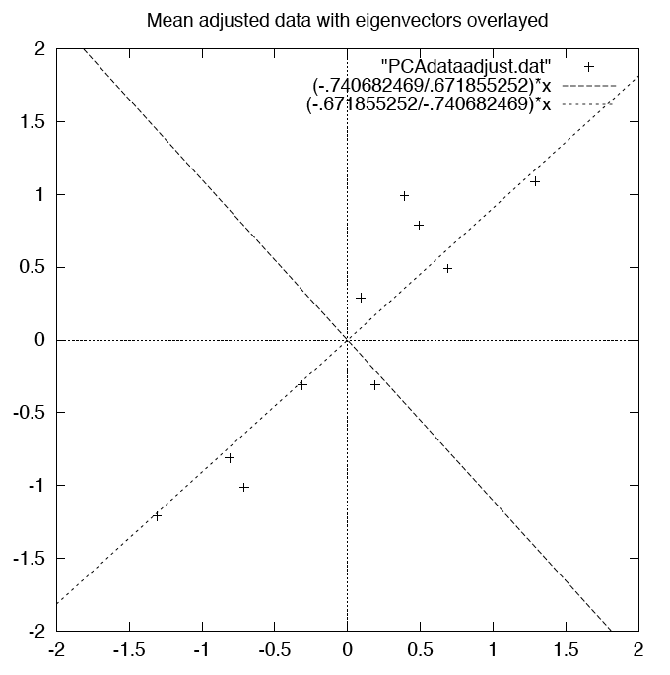
PCA – WORKED EXAMPLE
Step 3
Two eigenvectors overlaying the centered data

Slide 105
PCA – WORKED EXAMPLE
Step 4
Just keep the p eigenvectors with the largest eigenvalues
Do lose some information, but if we just drop dimensions with small eigenvalues then we lose only a little information
We can then have p input features rather than n
How many dimensions p should we keep?
Eigenvalue
Proportion
of Variance
1 2 3 4 5 6 7 … n

Slide 106
PCA – WORKED EXAMPLE
Step 4
Proportion of Variance (PoV)
when λ_{i} are sorted in descending order
Typically, stop at PoV>0.9

Slide 107
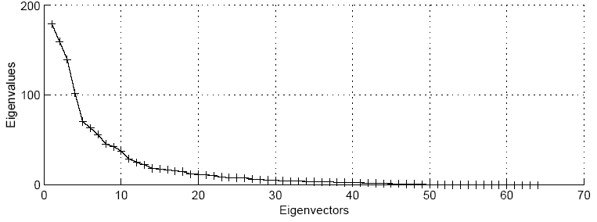
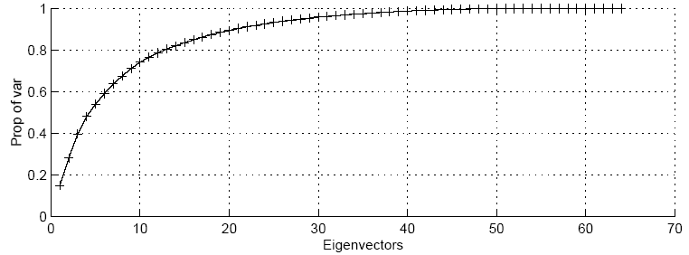
PCA – WORKED EXAMPLE
Step 4

Slide 108
PCA – WORKED EXAMPLE
Step 4
Transform the features to the p chosen Eigenvectors
Take the p eigenvectors that you want to keep from the list of eigenvectors, and forming a matrix with these eigenvectors in the columns.
For our example; either keep both vectors or chose to leave out the smaller less significant one
OR

Slide 109
PCA – WORKED EXAMPLE
Step 5
FinalData = RowFeatureVector x RowDataAdjust
RowFeatureVector is matrix with eigenvectors in the columns transposed so that eigenvectors are now in the rows with most significant eigenvector at the top
RowDataAdjust is the mean-adjusted data transposed
FinalData is the final data set with data items in columns and dimensions along the rows

Slide 110
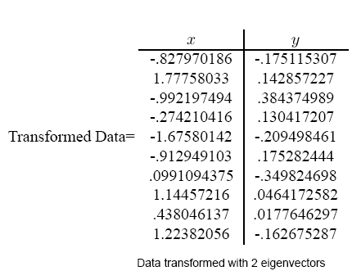
PCA – WORKED EXAMPLE
Step 5

Slide 111
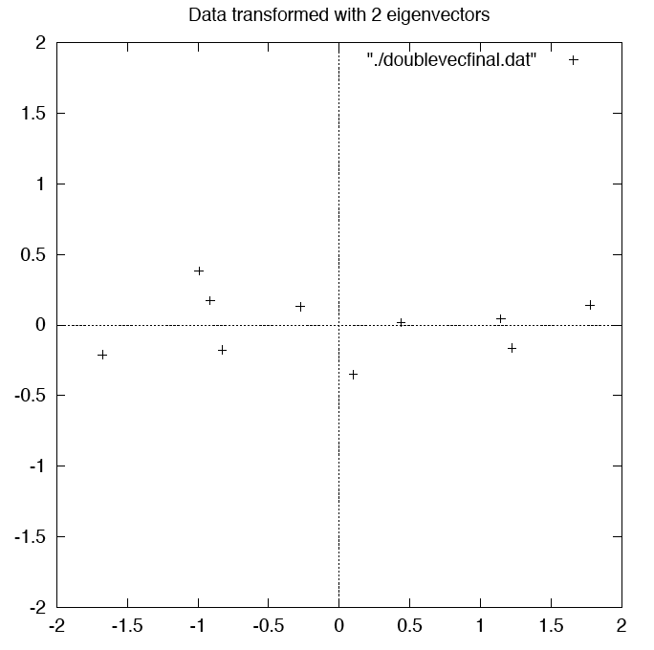
PCA – WORKED EXAMPLE
Step 5

Slide 112
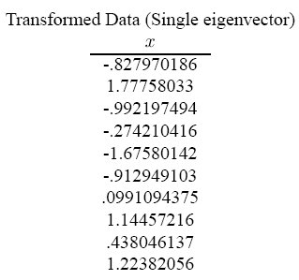
PCA – WORKED EXAMPLE
Step 5

Slide 113
PCA – WORKED EXAMPLE
Getting back original data
We used the transofrmation
This gives
In our case, inverse of feature vector is equal to its transpose
FinalData = RowFeatureVector x RowDataAdjust
RowDataAdjust = RowFeatureVector⁻¹ x FinalData
RowDataAdjust = RowFeatureVector^{T} x FinalData

Slide 114
PCA – WORKED EXAMPLE
Getting back original data
Add mean to get back raw data:
If we use all (two in our case) eigenvectors we get back exactly the original data
With one eigenvector, some information is lost
OriginalData= (RowFeatureVector^{T} x FinalData) + Mean

Slide 115
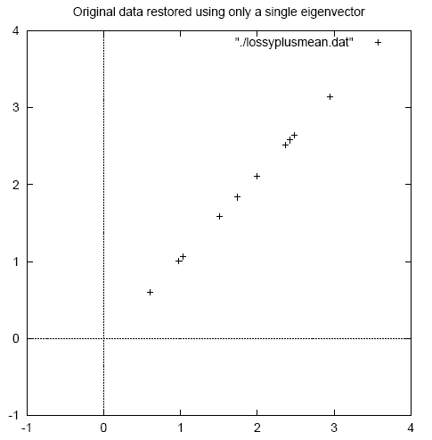
PCA – WORKED EXAMPLE
Original Data
Original Data restored with one eigenvector

Slide 116
PCA Applications
Eigenfaces for recognition. Turk and Pentland. 1991.
Principal Component Analysis for clustering gene expression data. Yeung and Ruzzo. 2001.
Probabilistic Disease Classification of Expression-Dependent Proteomic Data from Mass Spectrometry of Human Serum. Lilien. 2003.

Slide 117
Acknowledgements
Chapter 6, Introduction to Machine Learning, E. Alpyadin, MIT Press.
Most slides in this presentation are adopted from slides of text book and various sources. The Copyright belong to the original authors.

